Slide 1
CS6120: Lecture 4
Kenneth Church
https://kwchurch.github.io

Slide 2
Agenda
Homework
Assignment 2: HuggingFace Pipelines
Background Material
Old Business
Colab
Deep Nets: Inference
Classification & Regression
Anything → Vector
Machine Translation
Fill Mask
New Business
bertviz
Deep Nets: Fine-Tuning
Easy: inference
Hard: pre-training
Not too hard: fine-tuning
Code: colab
HuggingFace Tutorial
HuggingFace Colab
run glue example

Slide 3

https://gluebenchmark.com/

Slide 4
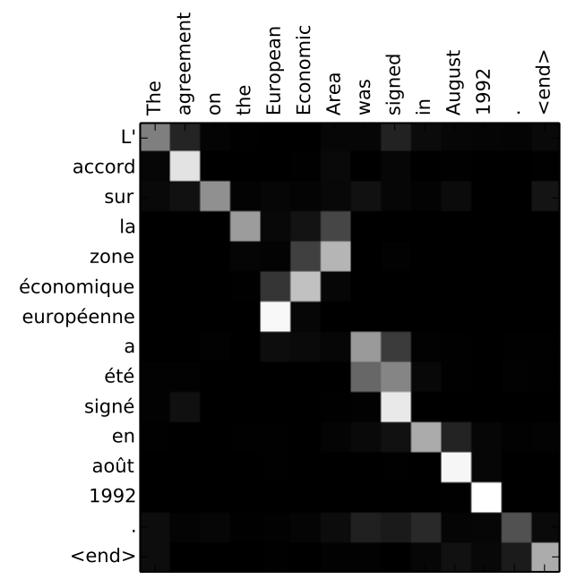
Attention used to be called Alignment
Attention is just another learned parameter, a number for each encoder hidden layer for each decoding step, softmaxed to be between 0 and 1
At each decoding step, concatenate the current hidden layer with a combination of the attention-multiplied encoder hidden states, and pass this vector into a feedforward layer to get the output word at this step
From slides from last year
https://jalammar.github.io/visualizing-neural-machine-translation-mechanics-of-seq2seq-models-with-attention/

Slide 5
Some BERT Models https://github.com/google-research/bert
BERT-Large, Uncased (Whole Word Masking):
24-layer, 1024-hidden, 16-heads, 340M parameters
BERT-Large, Cased (Whole Word Masking):
24-layer, 1024-hidden, 16-heads, 340M parameters
BERT-Base, Uncased:
12-layer, 768-hidden, 12-heads, 110M parameters
BERT-Large, Uncased:
24-layer, 1024-hidden, 16-heads, 340M parameters
BERT-Base, Cased:
12-layer, 768-hidden, 12-heads , 110M parameters
BERT-Large, Cased:
24-layer, 1024-hidden, 16-heads, 340M parameters
BERT-Base, Multilingual Cased (New, recommended):
104 languages, 12-layer, 768-hidden, 12-heads, 110M parameters

Slide 6
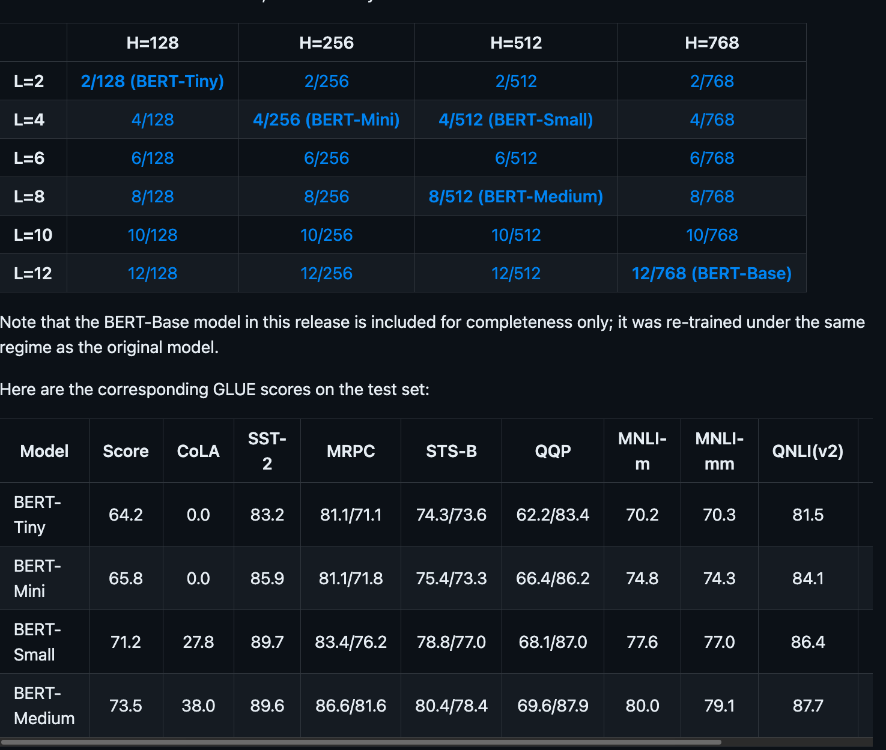
Smaller Models https://github.com/google-research/bert
Trade-off: Costs v. Performance
Costs:
Space
Time
Power
Industry Practice
Train large models and then make them smaller (distillation)

Slide 7
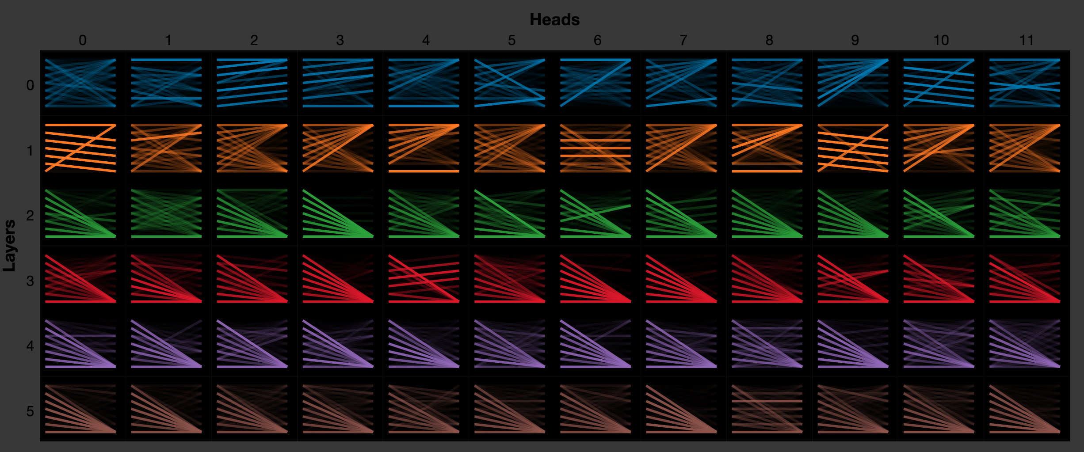
What do we mean by layers, heads, etc.? colab

Slide 8
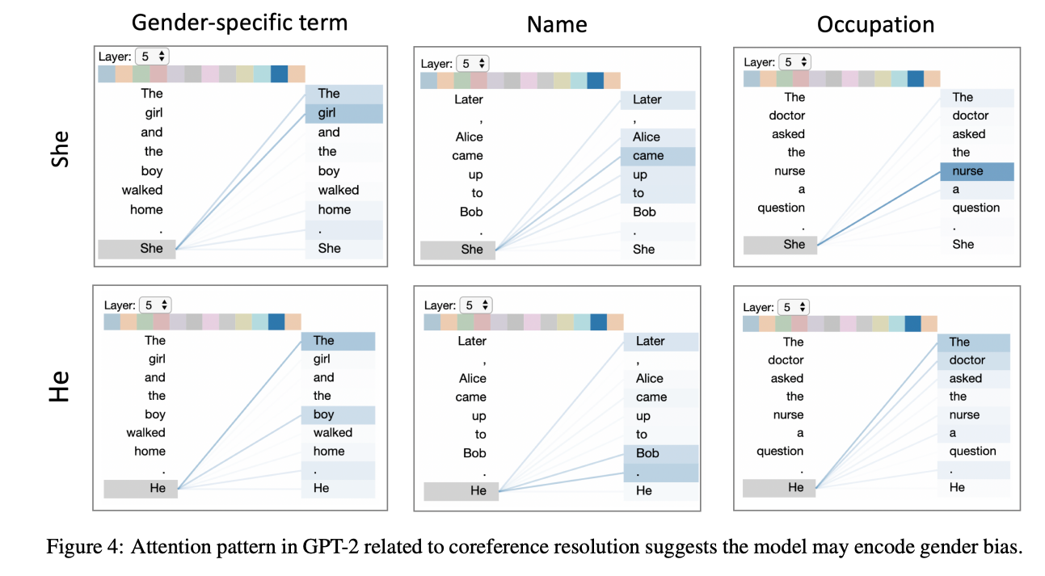
A Multiscale Visualization of Attention in the Transformer Model (bertviz) https://aclanthology.org/P19-3007.pdf

Slide 9
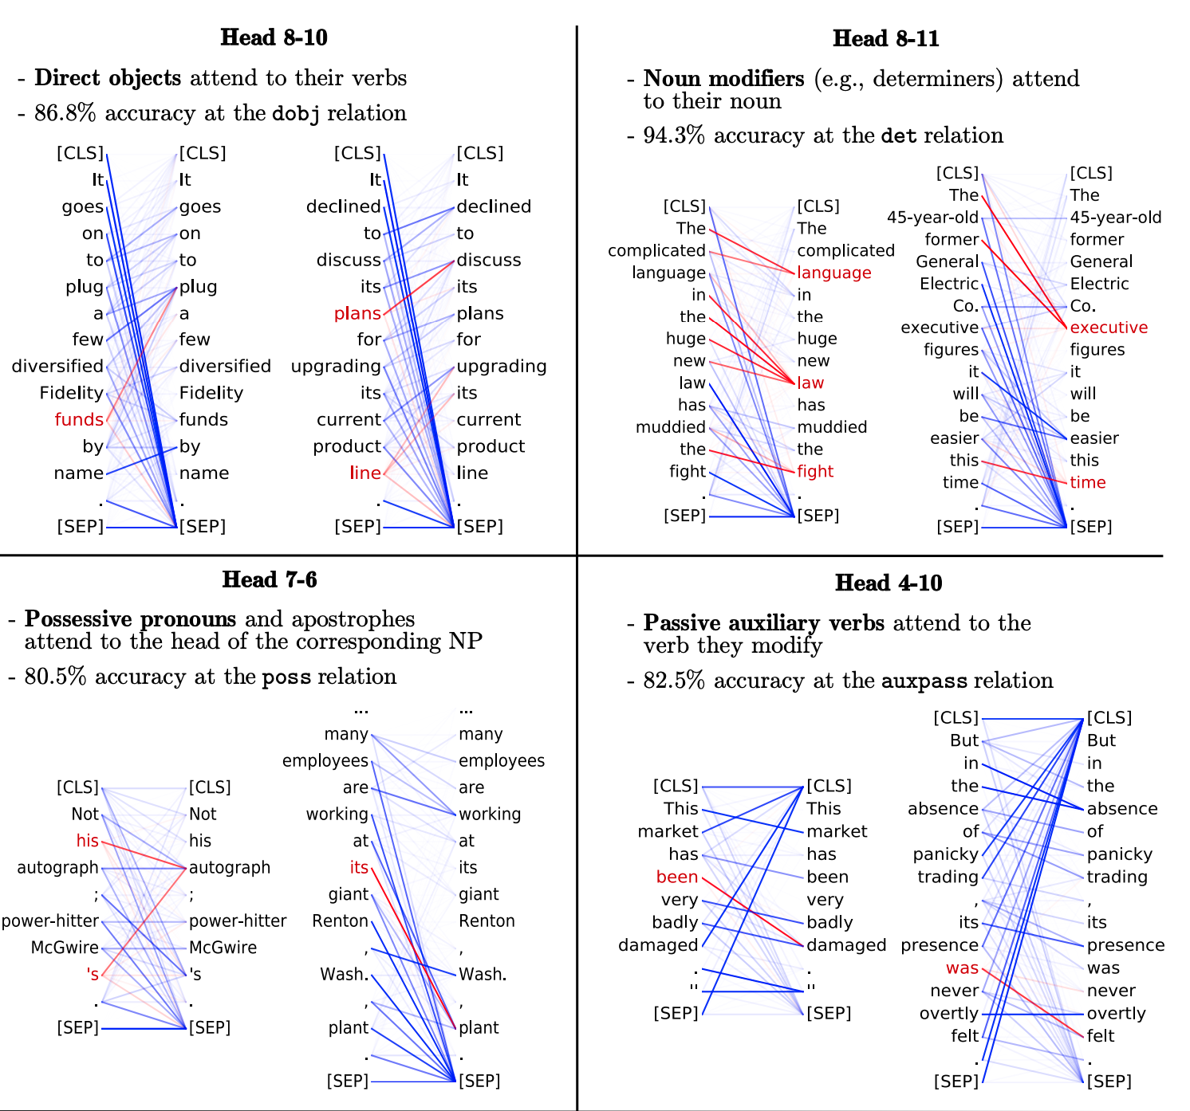
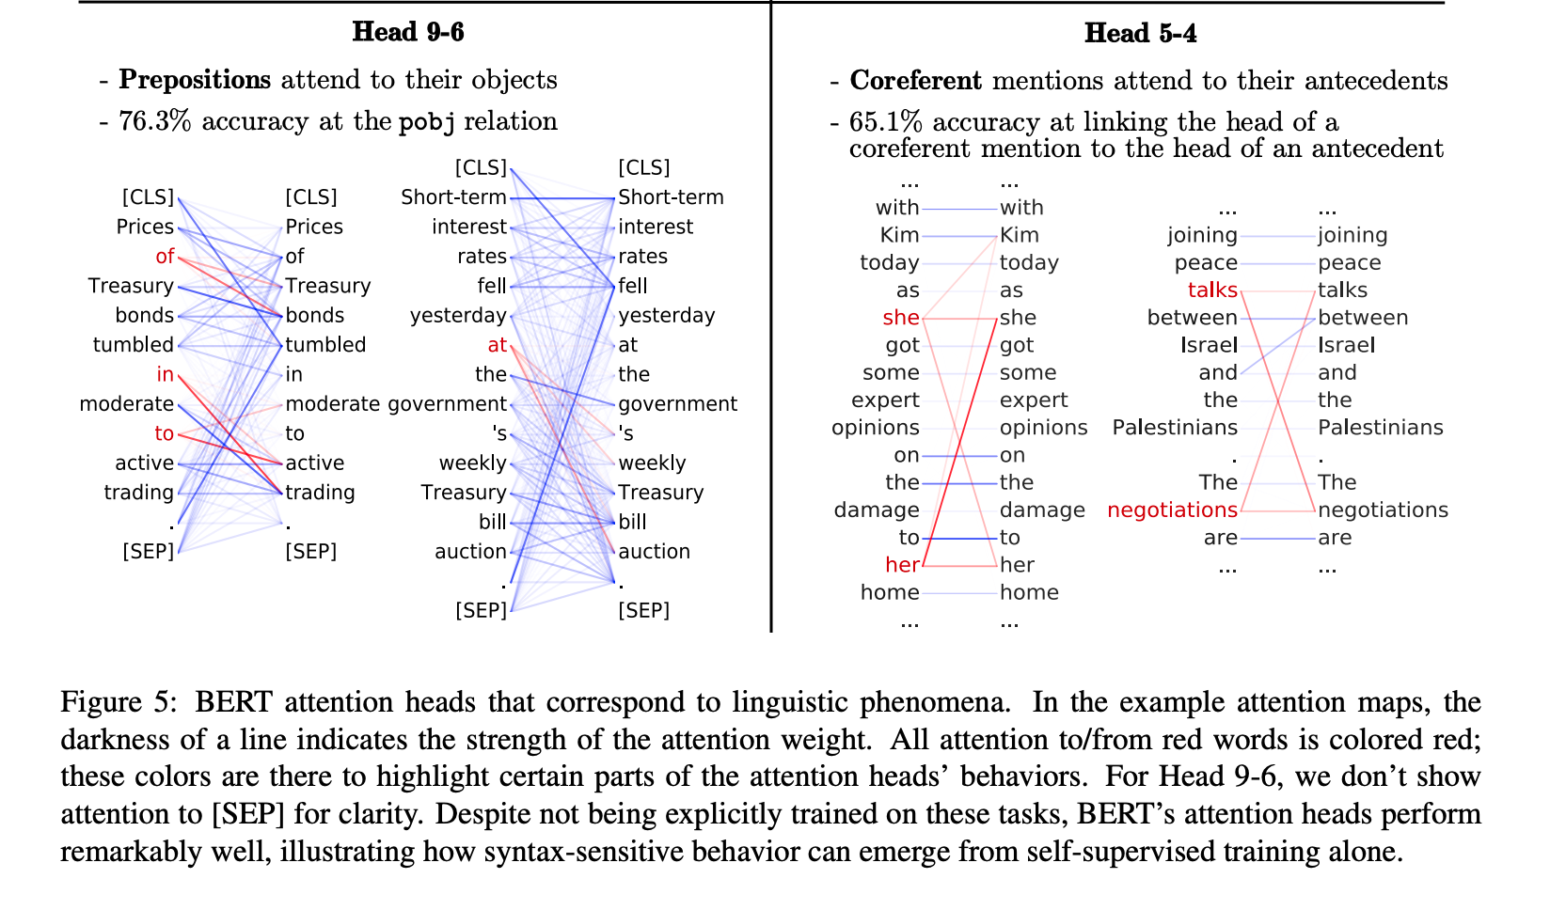
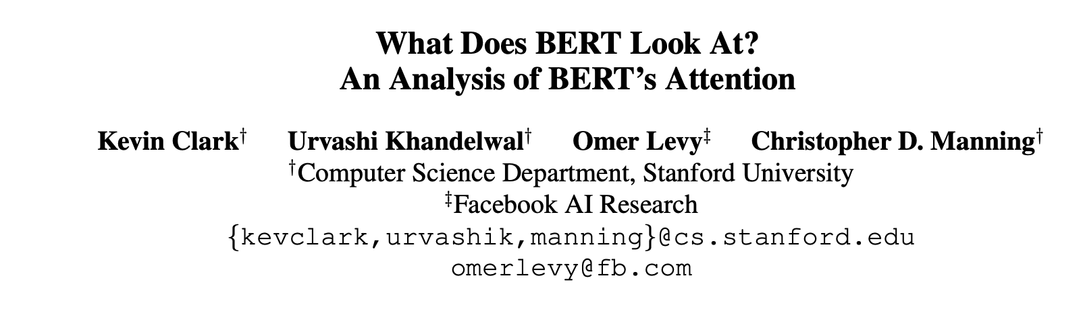
https://arxiv.org/pdf/1906.04341.pdf

Slide 10
Review

Slide 11
Standard 3-Step Recipe
Step | Description | Time | Hardware
1 | Pre-Training | Days/Weeks | Large GPU cluster
2 | Fine-Tuning (fit) | Hours/Days | 1+ GPUs
3 | Inference (predict) | Seconds/Minutes | 0+ GPUs
Not Hard

Slide 12

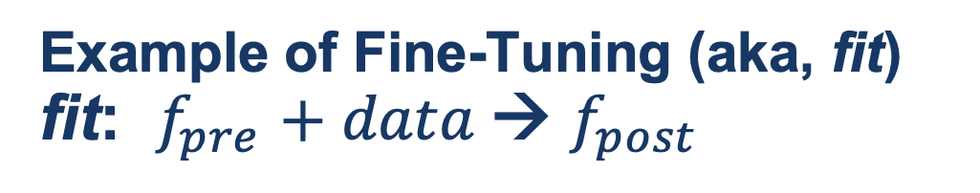
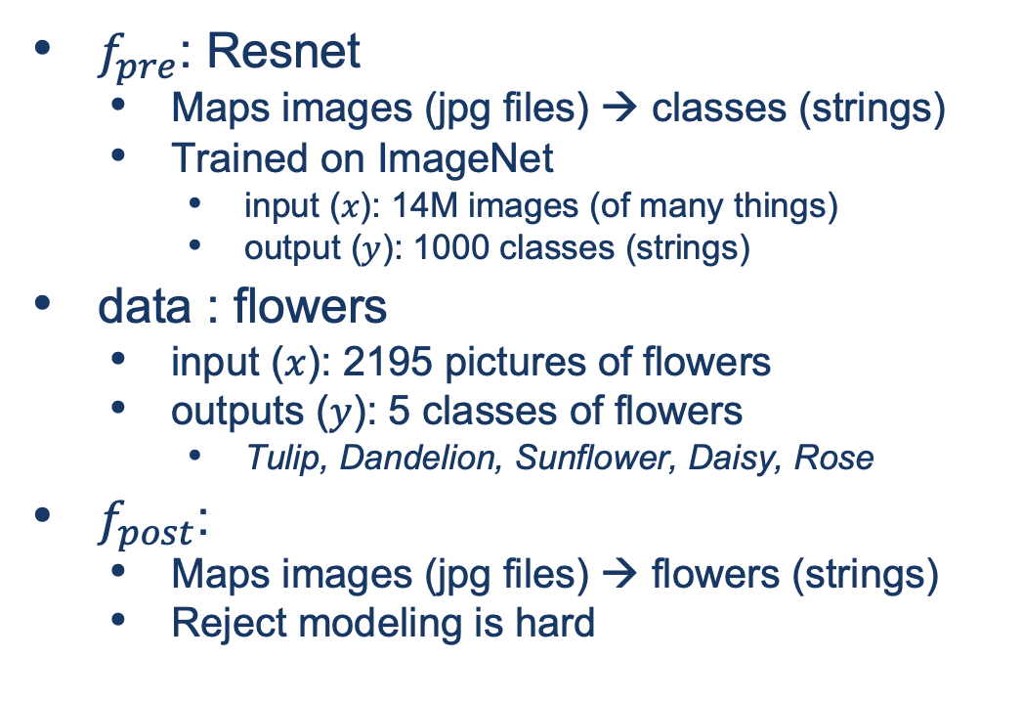
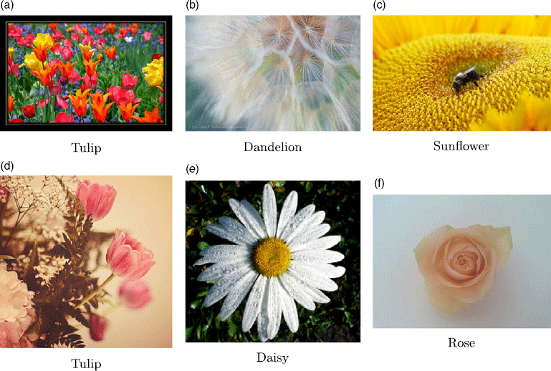
Guide Book App

Slide 13
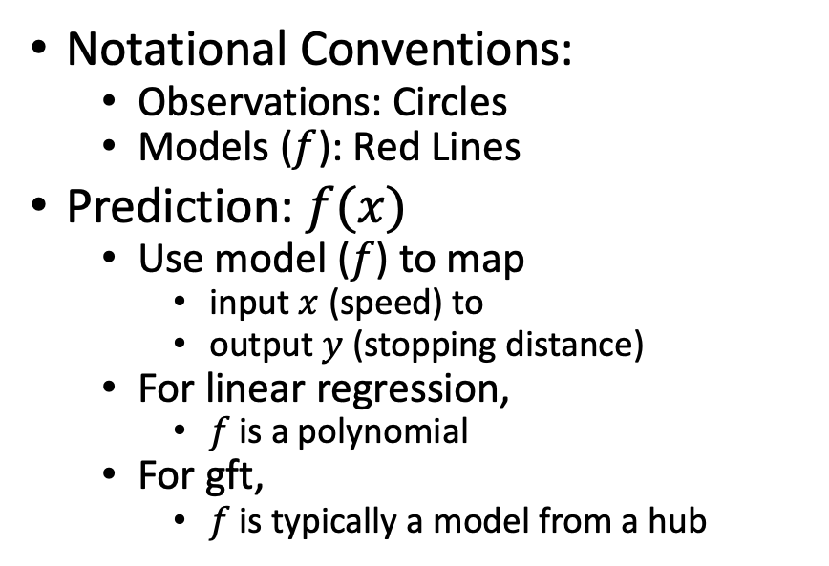
Fine-Tuning (Fit) in R (Statistics Package)
Make deep nets look like regression
(Not much programming)
Black Points:
cars dataset
Notational Conventions:
Observations: Circles
Models ($f$): Red Lines
Prediction: $f(x)$
Use model ($f$) to map
input $x$ (speed) to
output $y$ (stopping distance)
For linear regression,
$f$is a polynomial
For gft,
$f$is typically a model from a hub
Red Line:
Model (f)

Slide 14
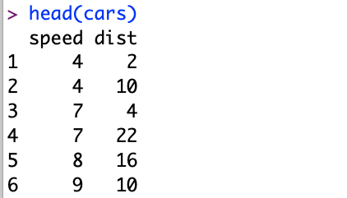
Datasets Example: Cars
Two Columns:
cars$speed
cars$dist

Slide 15
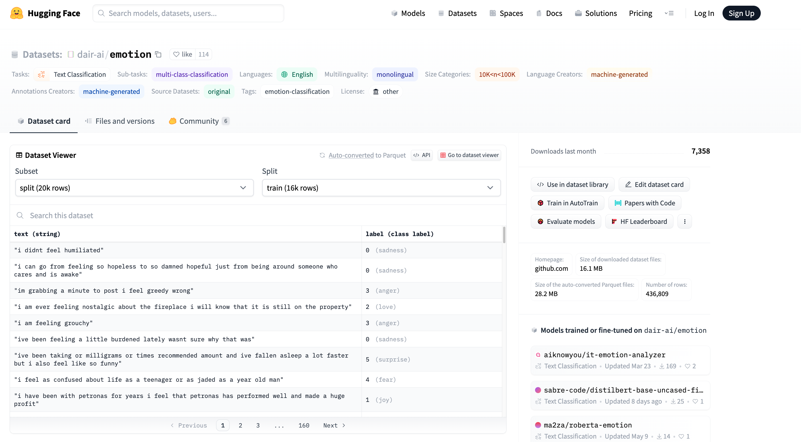


Example of Datasets in HuggingFace https://huggingface.co/datasets/dair-ai/emotion
$$x$$
$$y$$

Slide 16
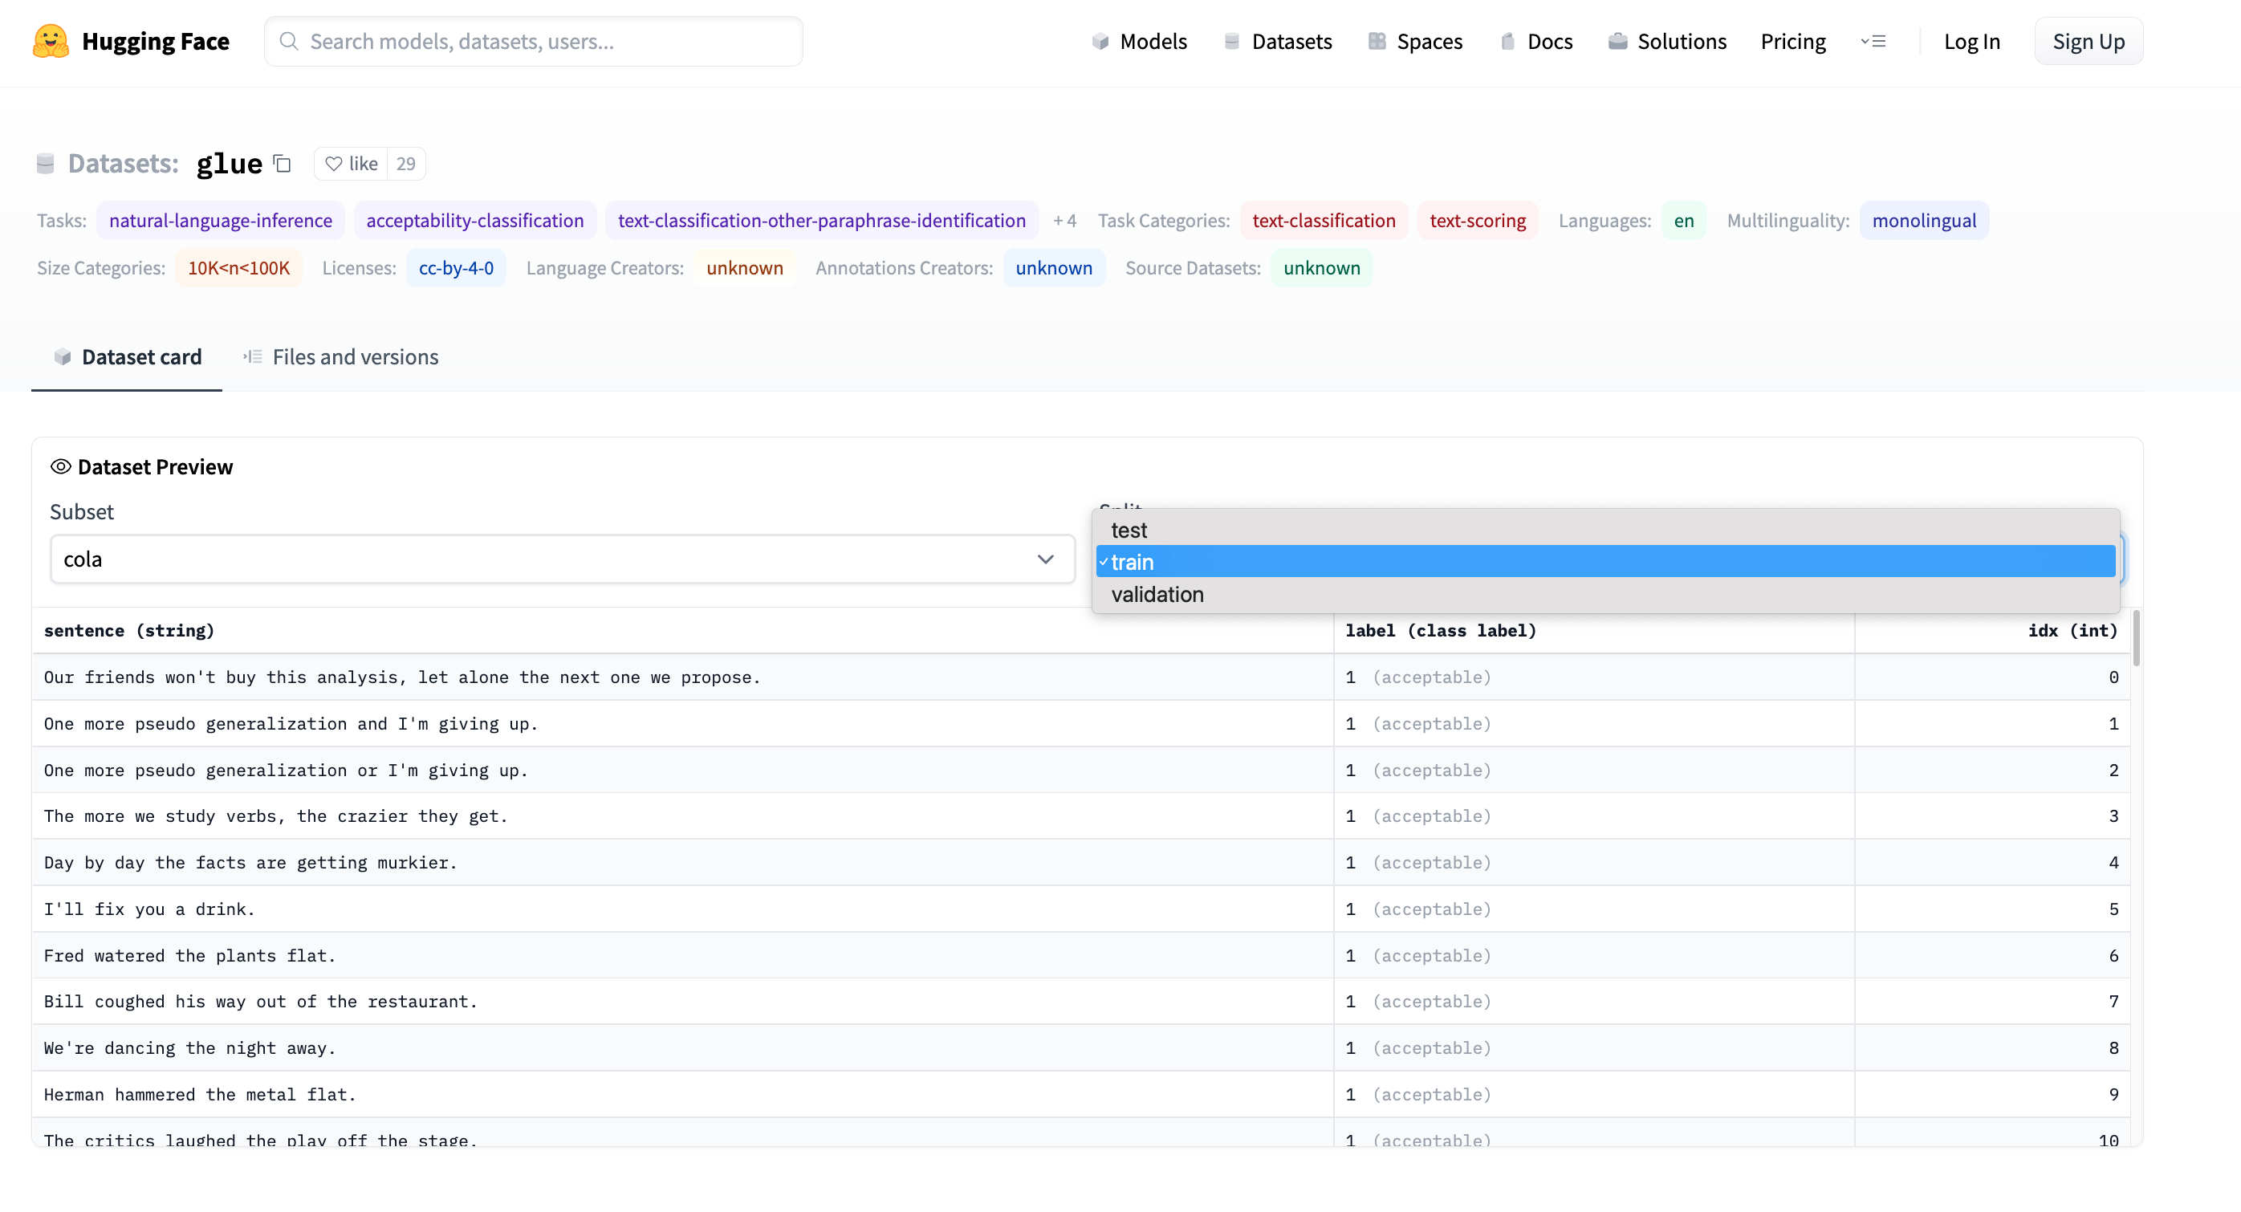
Emotion → GLUE (Cola) https://huggingface.co/datasets/glue/viewer/cola/train
Terminology: Splits
Terminology: Subset

Slide 17
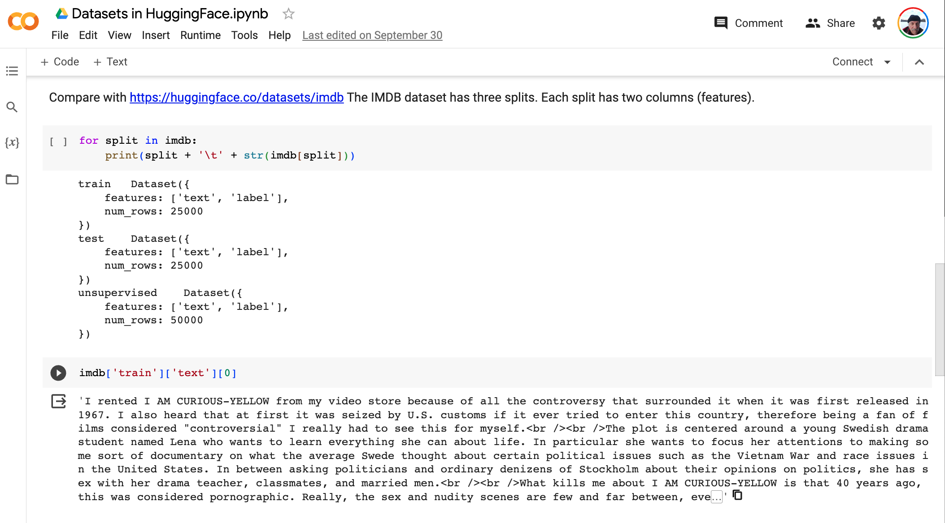
Datasets in HuggingFace colab

Slide 18
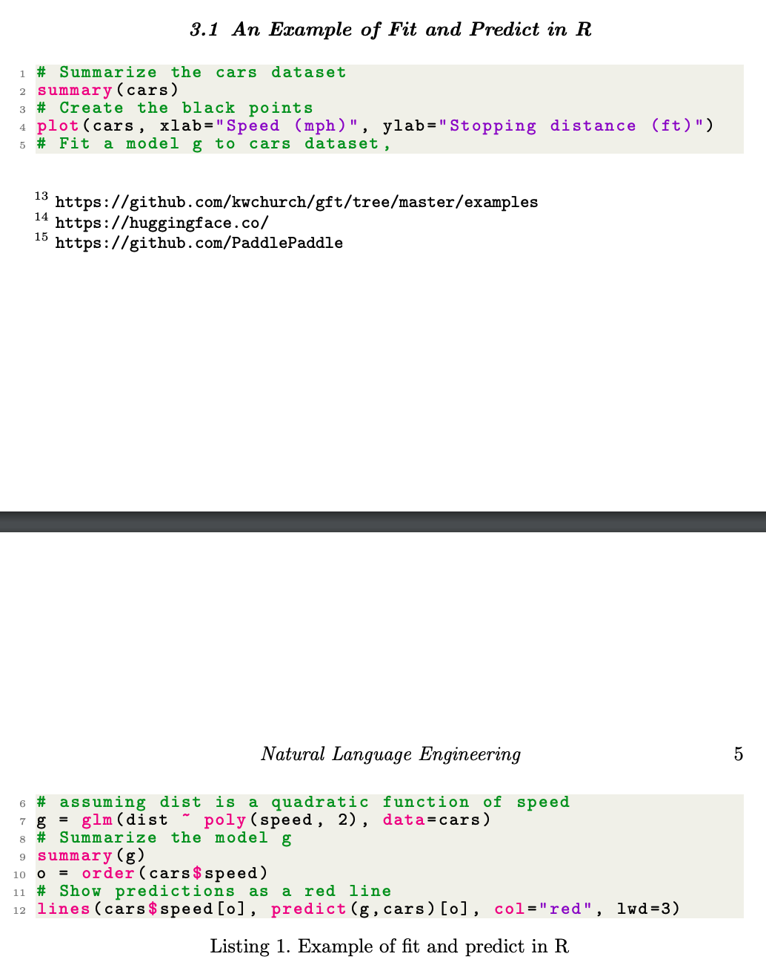
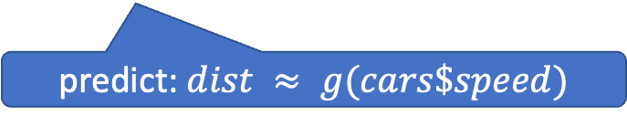
glm (General Linear Models) in R (and Sklearn)
glm: fit poly model with data
predict: $dist ≈ g(cars\$speed)$

Slide 19
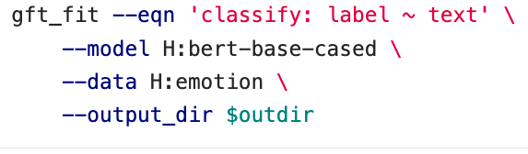
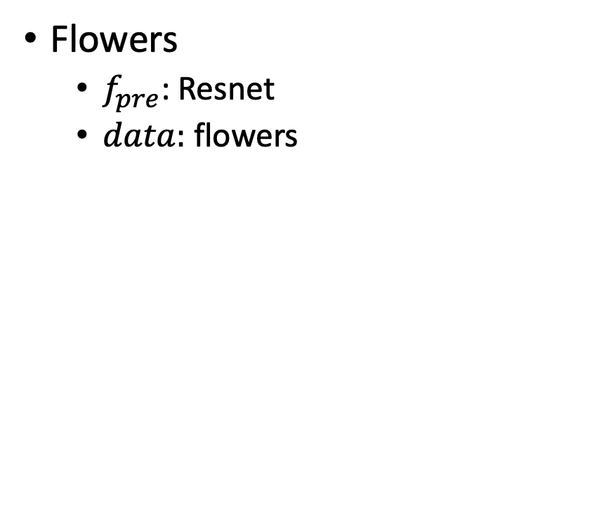
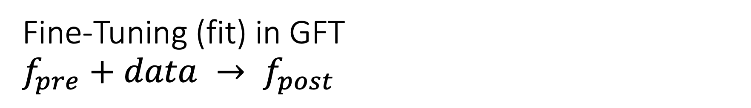
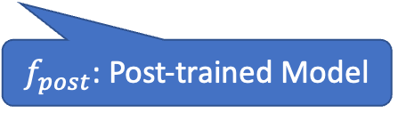
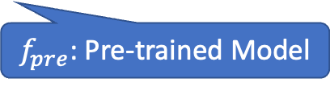
Fine-Tuning (fit) in GFT $f_{pre}+data → f_{post}$
Flowers
$f_{pre}$: Resnet
$data:$flowers
$f_{pre}$: Pre-trained Model
$f_{post}$: Post-trained Model
Fine-Tuning (fit) in R

Slide 20
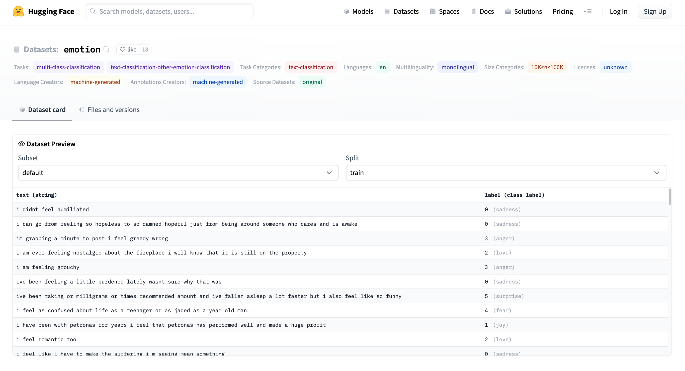
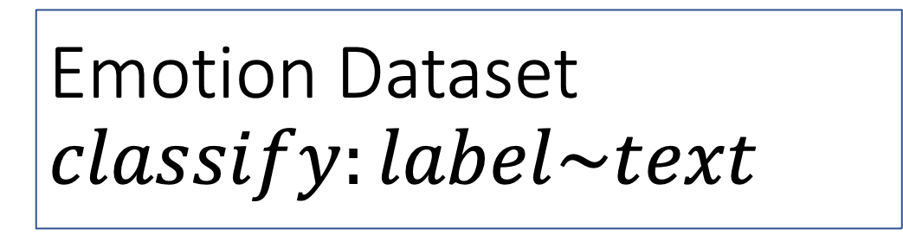
Emotion Dataset $$classify:label\sim text$$
Task/Loss
Columns
Columns
Row

Slide 21
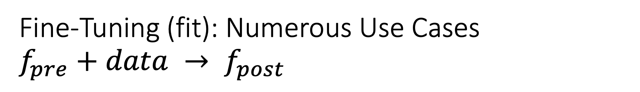
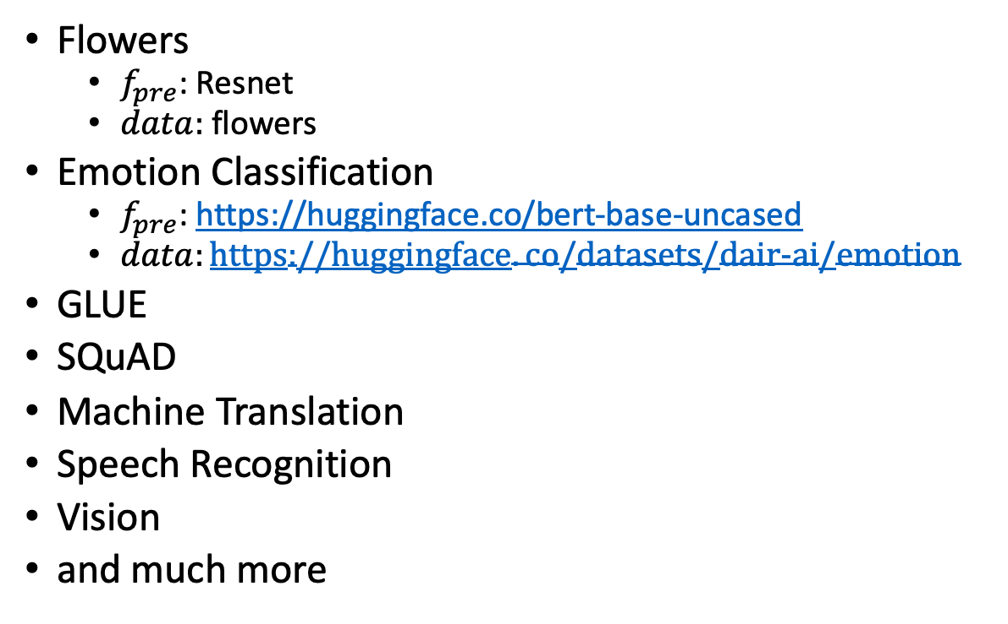
Fine-Tuning (fit): Numerous Use Cases $f_{pre}+data → f_{post}$
Flowers
$f_{pre}$: Resnet
$data:$flowers
Emotion Classification
$f_{pre}$: https://huggingface.co/bert-base-uncased
$data:https://huggingface.co/datasets/dair−ai/emotion$
GLUE
SQuAD
Machine Translation
Speech Recognition
Vision
and much more
$f_{pre}$: Pre-trained Model
$f_{post}$: Post-trained Model
Fine-Tuning (fit) in R

Slide 22
GLUE Subsets
GLUE COLA SUBSET
Sentence | Label
Bill sang himself to sleep. | 1 (acceptable)
Bill squeezed the puppet through the hole. | 1 (acceptable)
Bill sang Sue to sleep. | 1 (acceptable)
The elevator rumbled itself to the ground. | 0 (unacceptable)
If the telephone rang, it could ring itself silly. | 1 (acceptable)
She yelled hoarse. | 0 (unacceptable)
Ted cried to sleep. | 0 (unacceptable)
The tiger bled to death. | 1 (acceptable)
Subset | Dataset
COLA | H:glue,cola
SST2 | H:glue,sst2
WNLI | H:glue,wnli
MRPC | H:glue,mrpc
QNLI | H:glue,qnli
QQP | H:glue,qqp
SSTB | H:glue,sstb
MNLI | H:glue,mnli

Slide 23
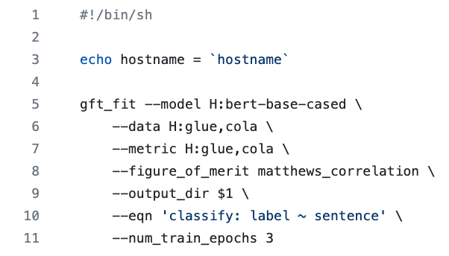
GFT Program for COLA
GLUE COLA SUBSET
Sentence | Label
Bill sang himself to sleep. | 1 (acceptable)
Bill squeezed the puppet through the hole. | 1 (acceptable)
Bill sang Sue to sleep. | 1 (acceptable)
The elevator rumbled itself to the ground. | 0 (unacceptable)
If the telephone rang, it could ring itself silly. | 1 (acceptable)
She yelled hoarse. | 0 (unacceptable)
Ted cried to sleep. | 0 (unacceptable)
The tiger bled to death. | 1 (acceptable)
https://github.com/kwchurch/gft/blob/master/examples/fit_examples/model.HuggingFace/language/data.HuggingFace/glue/cola.sh

Slide 24
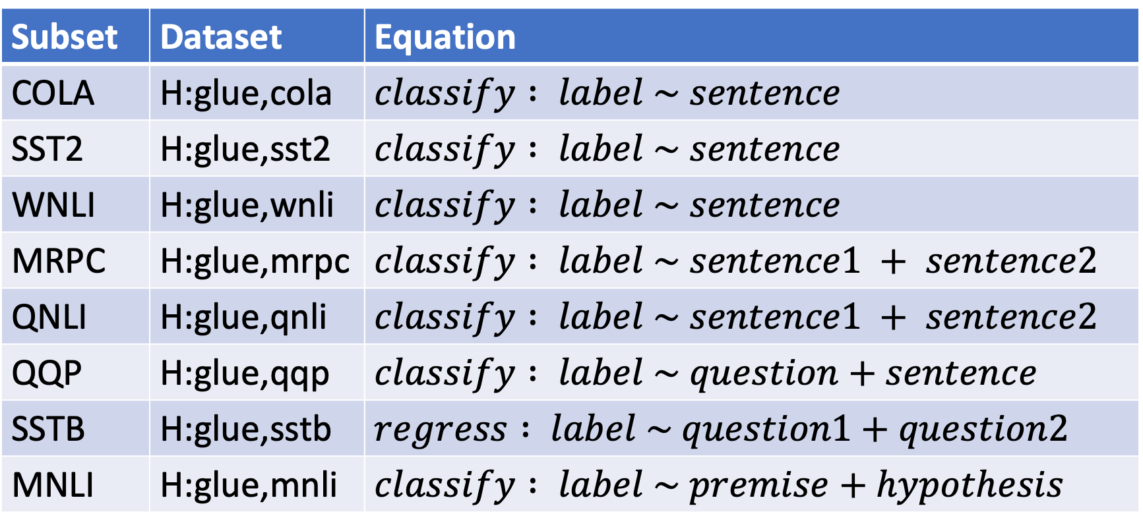
Simple Equations Cover Many Cases of Interest GLUE: A Popular Benchmark
Subset | Dataset | Equation
COLA | H:glue,cola | $$classify : label \sim sentence$$
SST2 | H:glue,sst2 | $$classify : label \sim sentence$$
WNLI | H:glue,wnli | $$classify : label \sim sentence$$
MRPC | H:glue,mrpc | $$classify : label \sim sentence1 + sentence2$$
QNLI | H:glue,qnli | $$classify : label \sim sentence1 + sentence2$$
QQP | H:glue,qqp | $$classify : label \sim question+sentence$$
SSTB | H:glue,sstb | $$regress : label \sim question1+question2$$
MNLI | H:glue,mnli | $$classify : label \sim premise+hypothesis$$

Slide 25
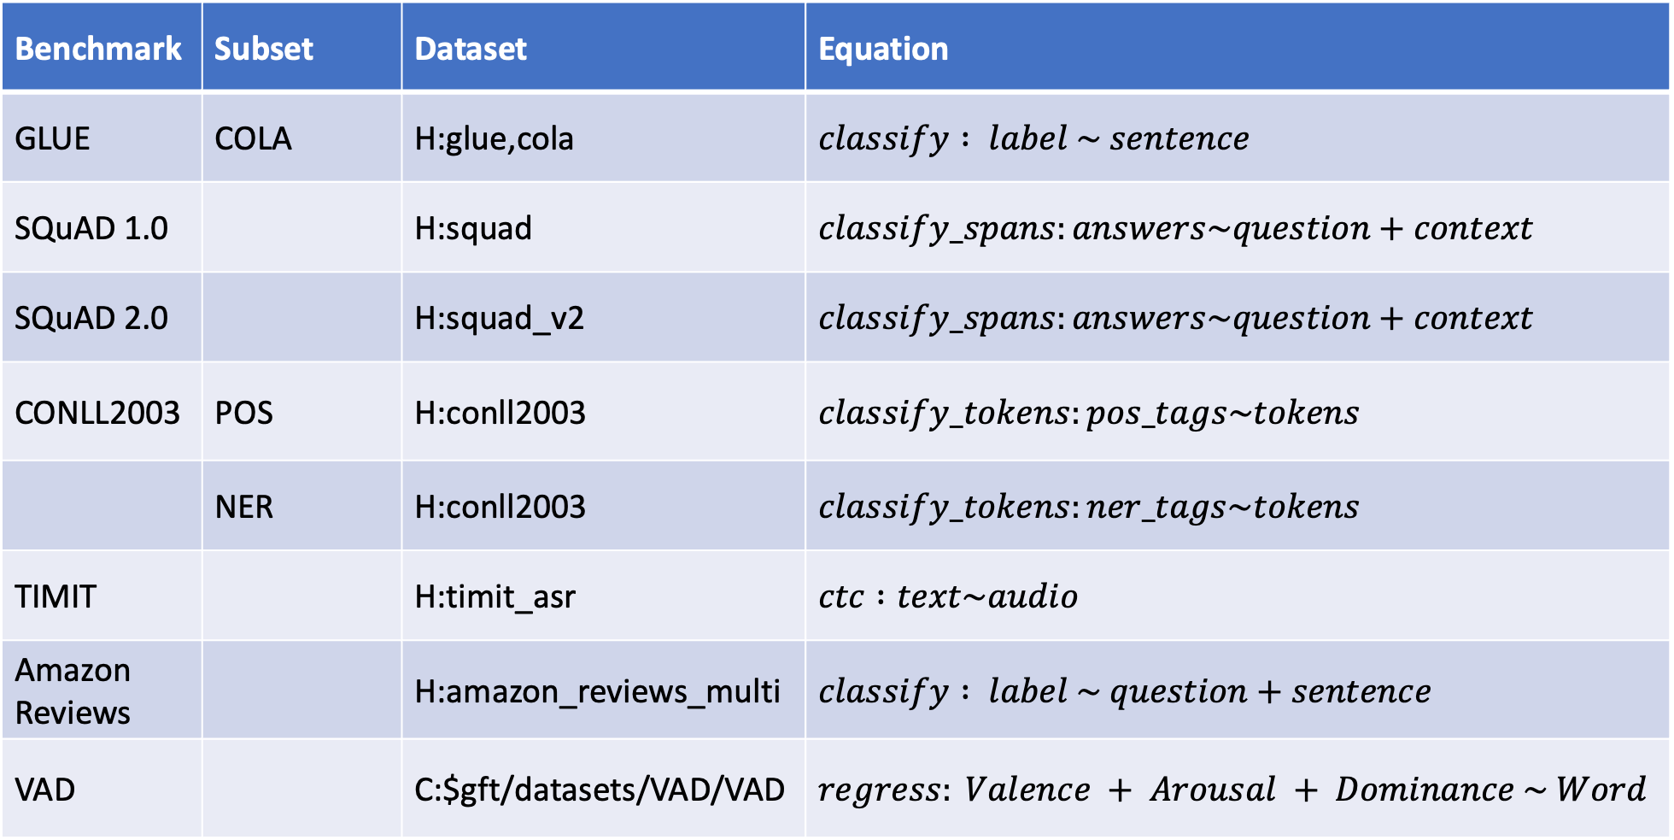
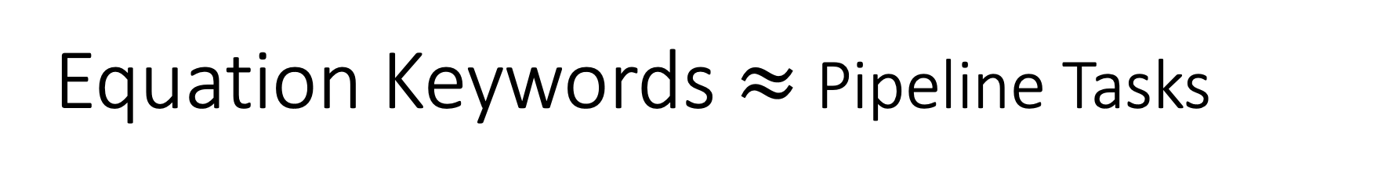
Equation Keywords $≈$ Pipeline Tasks
Benchmark | Subset | Dataset | Equation
GLUE | COLA | H:glue,cola | $$classify : label \sim sentence$$
SQuAD 1.0 |  | H:squad | $$classify_spans:answers\sim question+context$$
SQuAD 2.0 |  | H:squad_v2 | $$classify_spans:answers\sim question+context$$
CONLL2003 | POS | H:conll2003 | $$classify_tokens:pos_tags\sim tokens$$
 | NER | H:conll2003 | $$classify_tokens:ner_tags\sim tokens$$
TIMIT |  | H:timit_asr | $$ctc :text\sim audio$$
Amazon Reviews |  | H:amazon_reviews_multi | $$classify : label \sim question+sentence$$
VAD |  | C:$gft/datasets/VAD/VAD | $$regress: Valence + Arousal + Dominance \sim Word$$

Slide 26
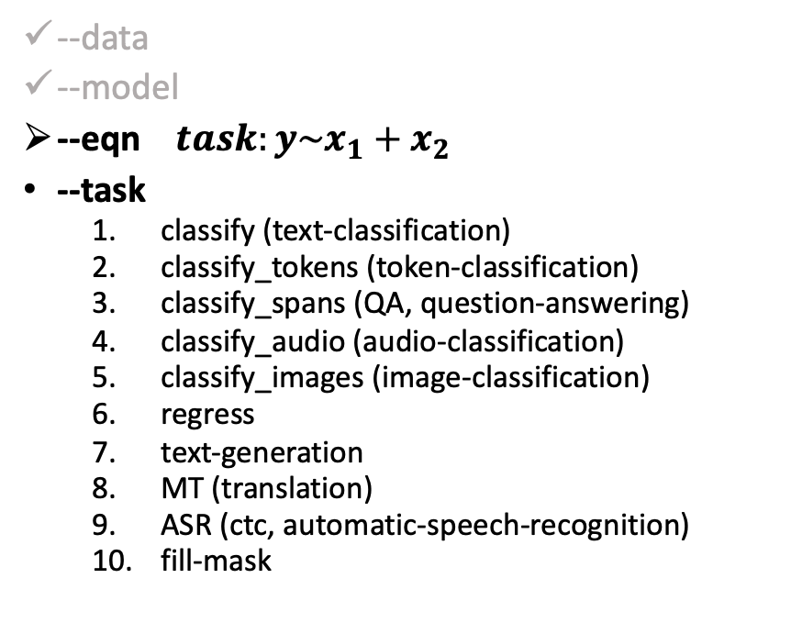
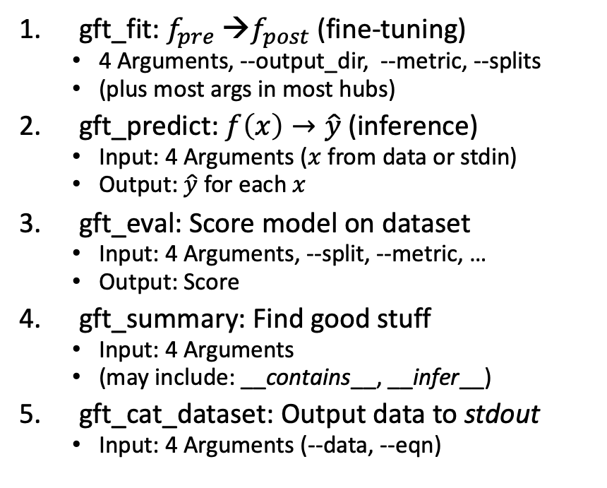
gft Cheat Sheet (General Fine-Tuning)
4+1 Functions
4 Arguments
gft_fit: $f_{pre}$ →$f_{post}$(fine-tuning)
4 Arguments, --output_dir, --metric, --splits
(plus most args in most hubs)
gft_predict: $f\left(x\right)→\hat{y}$ (inference)
Input: 4 Arguments ($x$ from data or stdin)
Output: $\hat{y}$ for each $x$
gft_eval: Score model on dataset
Input: 4 Arguments, --split, --metric, …
Output: Score
gft_summary: Find good stuff
Input: 4 Arguments
(may include: __contains__, __infer__)
gft_cat_dataset: Output data to stdout
Input: 4 Arguments (--data, --eqn)
--data
--model
--eqn $task:y\sim x_{1}+x_{2}$
--task
classify (text-classification)
classify_tokens (token-classification)
classify_spans (QA, question-answering)
classify_audio (audio-classification)
classify_images (image-classification)
regress
text-generation
MT (translation)
ASR (ctc, automatic-speech-recognition)
fill-mask

Slide 27
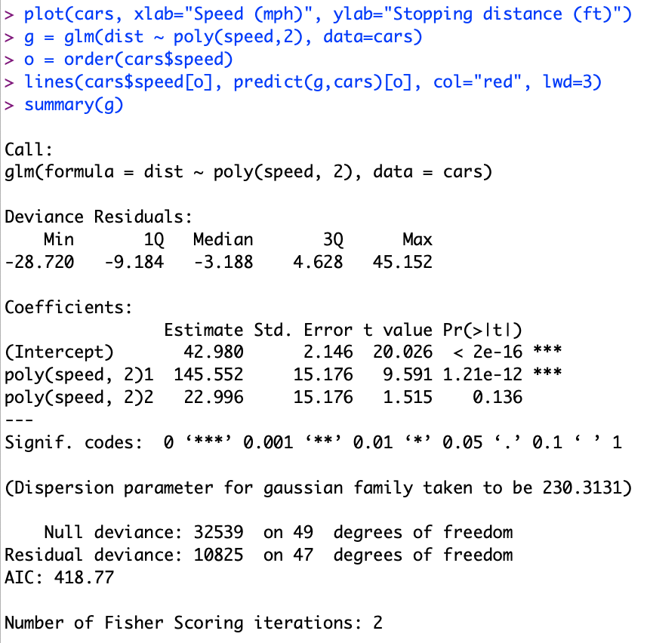
Regression in R: Summarize (almost) anything
Fit a model (g) to data (cars)

Slide 28
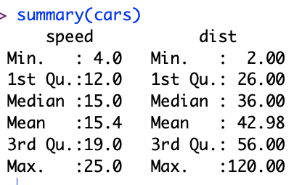
Regression in R: Summarize (almost) anything

Slide 29
Regression in R: Summarize (almost) anything
Fit a model (g) to data (cars)
Predict
Summarize a model (g)
Opportunity to Improve g

Slide 30
gft_summary
Summarize almost anything
Models
Datasets

Slide 31



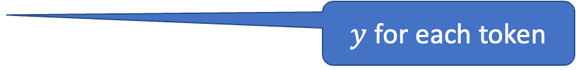

Tasks
$$y∈\left\{0,1,2,…\right\}$$
classify, text-classification
regress
QA, Question Answering, classify spans
token classification
NER (Named Entity Recognition)
POS (Part of Speech Tagging)
translation, MT
ASR, Automatic Speech Recognition, ctc
$y∈ℝ$ or $y∈ℝ^{N}$
$y$ for each start/end of span
$y$ for each token
$y$ for each phoneme

Slide 32
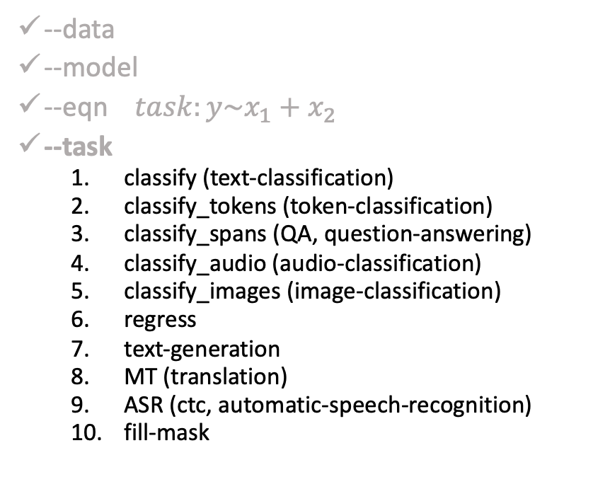
gft Cheat Sheet (General Fine-Tuning)
4+1 Functions
4 Arguments
gft_fit: $f_{pre}$ →$f_{post}$(fine-tuning)
4 Arguments, --output_dir, --metric, --splits
(plus most args in most hubs)
gft_predict: $f\left(x\right)→\hat{y}$ (inference)
Input: 4 Arguments ($x$ from data or stdin)
Output: $\hat{y}$ for each $x$
gft_eval: Score model on dataset
Input: 4 Arguments, --split, --metric, …
Output: Score
gft_summary: Find good stuff
Input: 4 Arguments
(may include: __contains__, __infer__)
gft_cat_dataset: Output data to stdout
Input: 4 Arguments (--data, --eqn)
--data
--model
--eqn $task:y\sim x_{1}+x_{2}$
--task
classify (text-classification)
classify_tokens (token-classification)
classify_spans (QA, question-answering)
classify_audio (audio-classification)
classify_images (image-classification)
regress
text-generation
MT (translation)
ASR (ctc, automatic-speech-recognition)
fill-mask

Slide 33
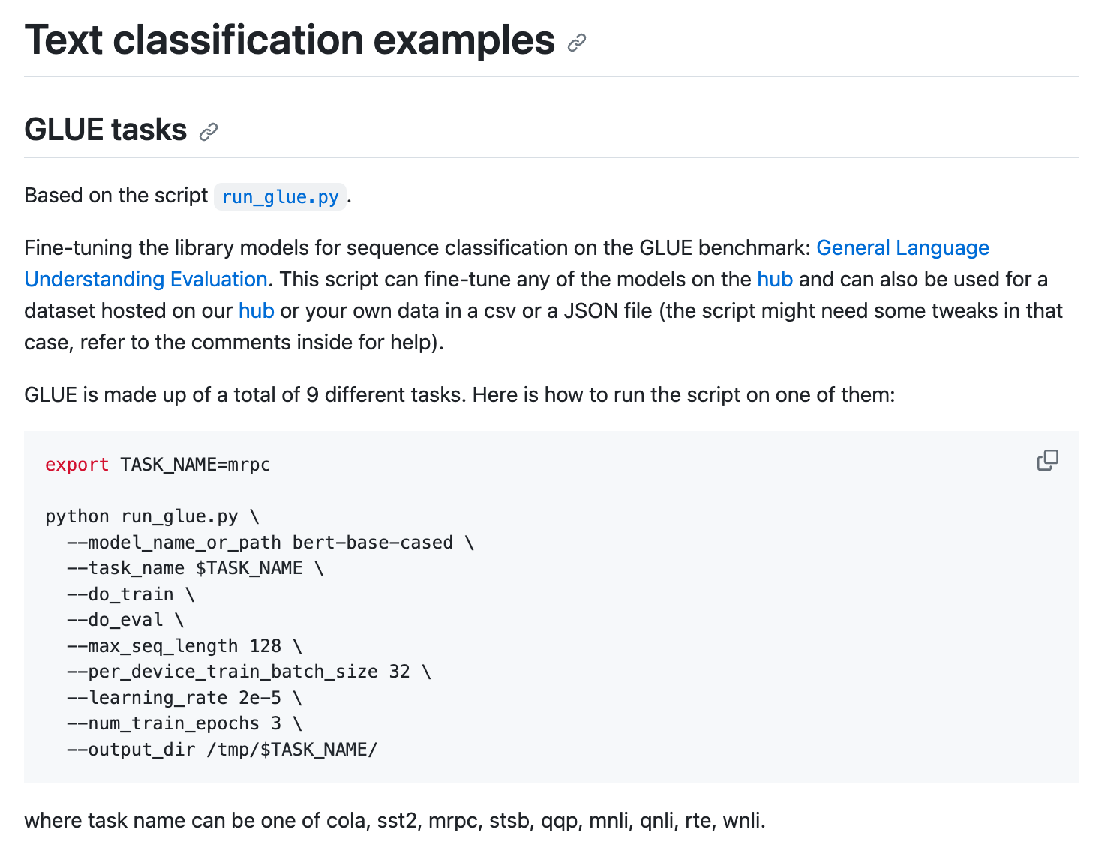
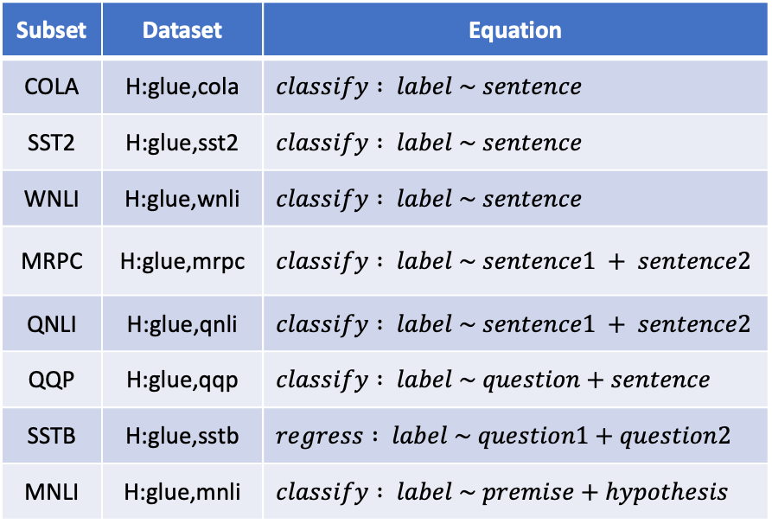
HuggingFace run_glue.py colab
GFT
https://github.com/huggingface/transformers/blob/main/examples/pytorch/text-classification/README.md
Subset | Dataset | Equation
COLA | H:glue,cola | $$classify : label \sim sentence$$
SST2 | H:glue,sst2 | $$classify : label \sim sentence$$
WNLI | H:glue,wnli | $$classify : label \sim sentence$$
MRPC | H:glue,mrpc | $$classify : label \sim sentence1 + sentence2$$
QNLI | H:glue,qnli | $$classify : label \sim sentence1 + sentence2$$
QQP | H:glue,qqp | $$classify : label \sim question+sentence$$
SSTB | H:glue,sstb | $$regress : label \sim question1+question2$$
MNLI | H:glue,mnli | $$classify : label \sim premise+hypothesis$$

Slide 34
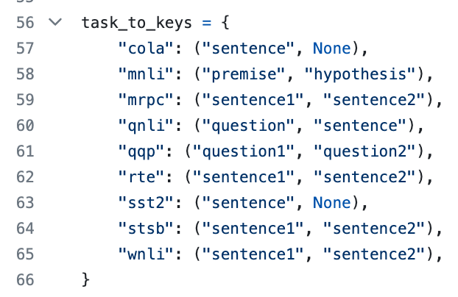
HuggingFace run_glue.py colab
GFT
https://github.com/huggingface/transformers/blob/main/examples/pytorch/text-classification/README.md
Subset | Dataset | Equation
COLA | H:glue,cola | $$classify : label \sim sentence$$
SST2 | H:glue,sst2 | $$classify : label \sim sentence$$
WNLI | H:glue,wnli | $$classify : label \sim sentence$$
MRPC | H:glue,mrpc | $$classify : label \sim sentence1 + sentence2$$
QNLI | H:glue,qnli | $$classify : label \sim sentence1 + sentence2$$
QQP | H:glue,qqp | $$classify : label \sim question+sentence$$
SSTB | H:glue,sstb | $$regress : label \sim question1+question2$$
MNLI | H:glue,mnli | $$classify : label \sim premise+hypothesis$$

Slide 35
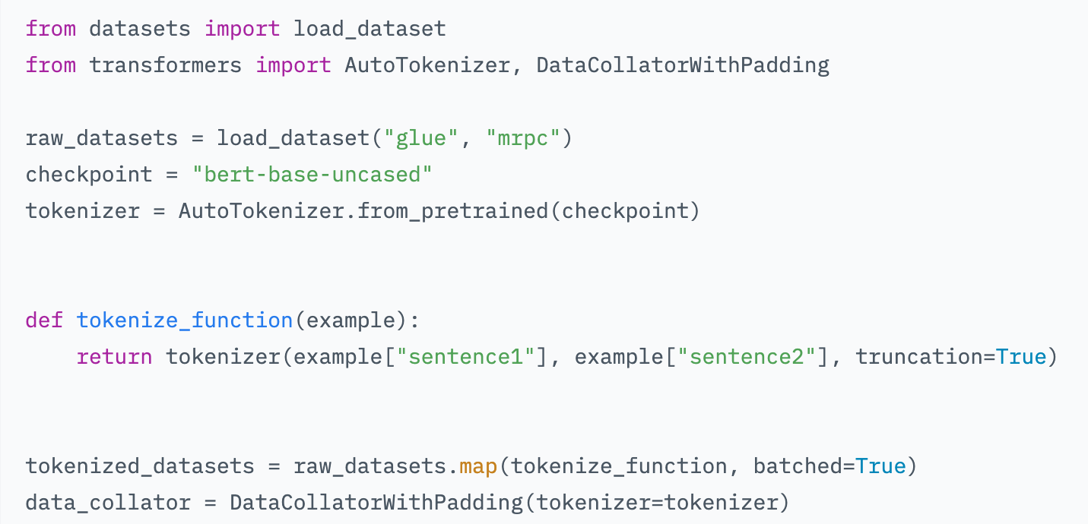
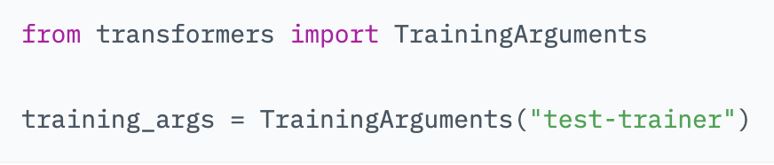
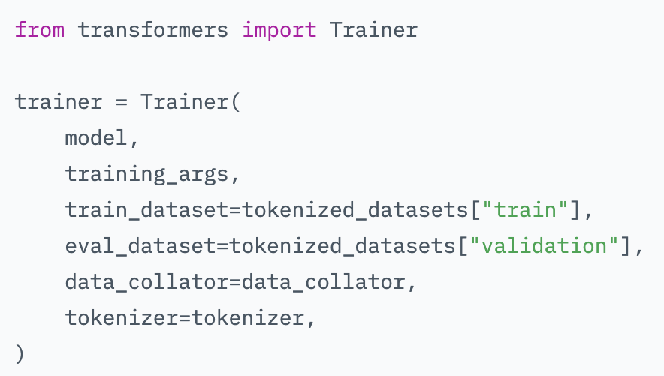
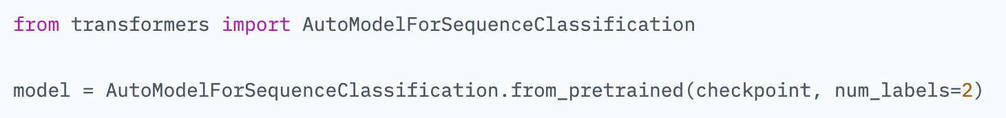
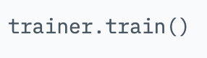
Trainer https://huggingface.co/learn/nlp-course/chapter3/3?fw=pt

Slide 36
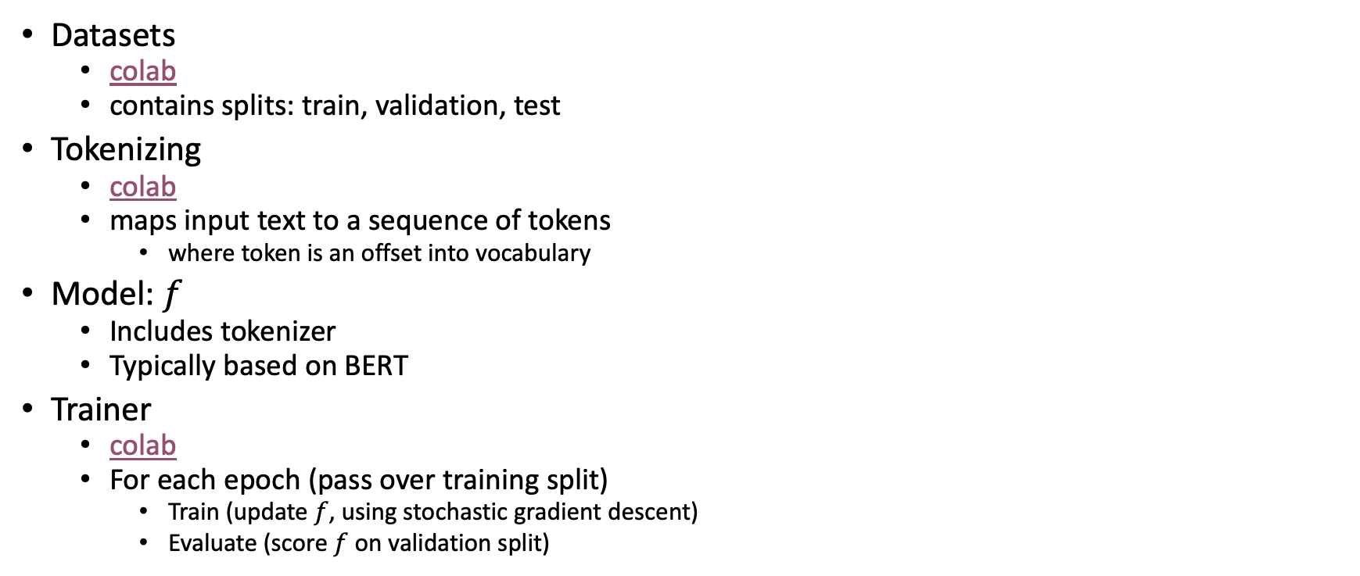
Steps
Datasets
colab
contains splits: train, validation, test
Tokenizing
colab
maps input text to a sequence of tokens
where token is an offset into vocabulary
Model: $f$
Includes tokenizer
Typically based on BERT
Trainer
colab
For each epoch (pass over training split)
Train (update $f$, using stochastic gradient descent)
Evaluate (score $f$ on validation split)

Slide 37
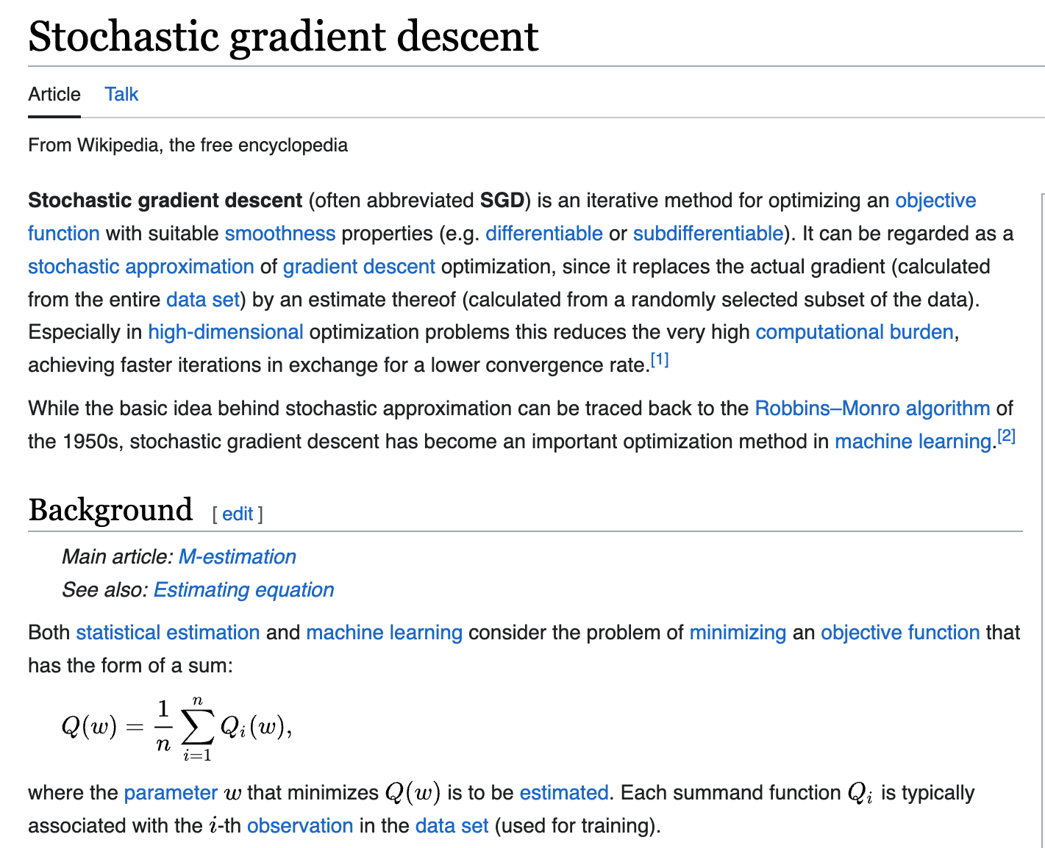
https://en.wikipedia.org/wiki/Stochastic_gradient_descent https://realpython.com/gradient-descent-algorithm-python

Slide 38
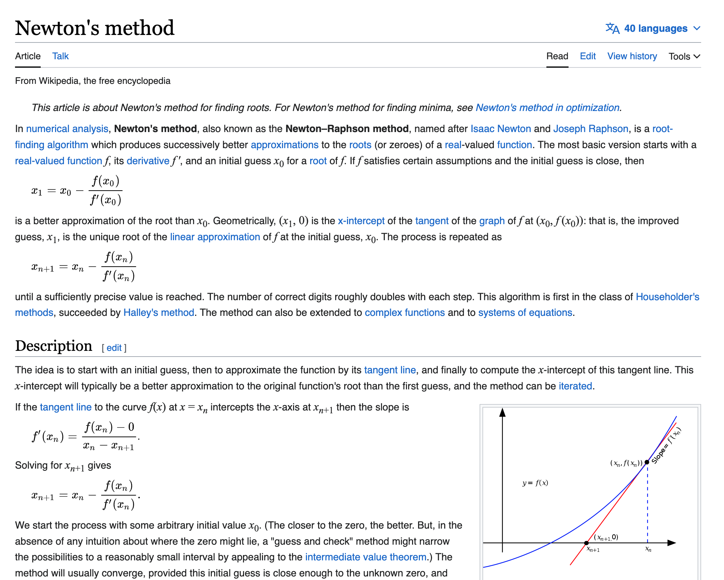
https://en.wikipedia.org/wiki/Newton%27s_method

Slide 39
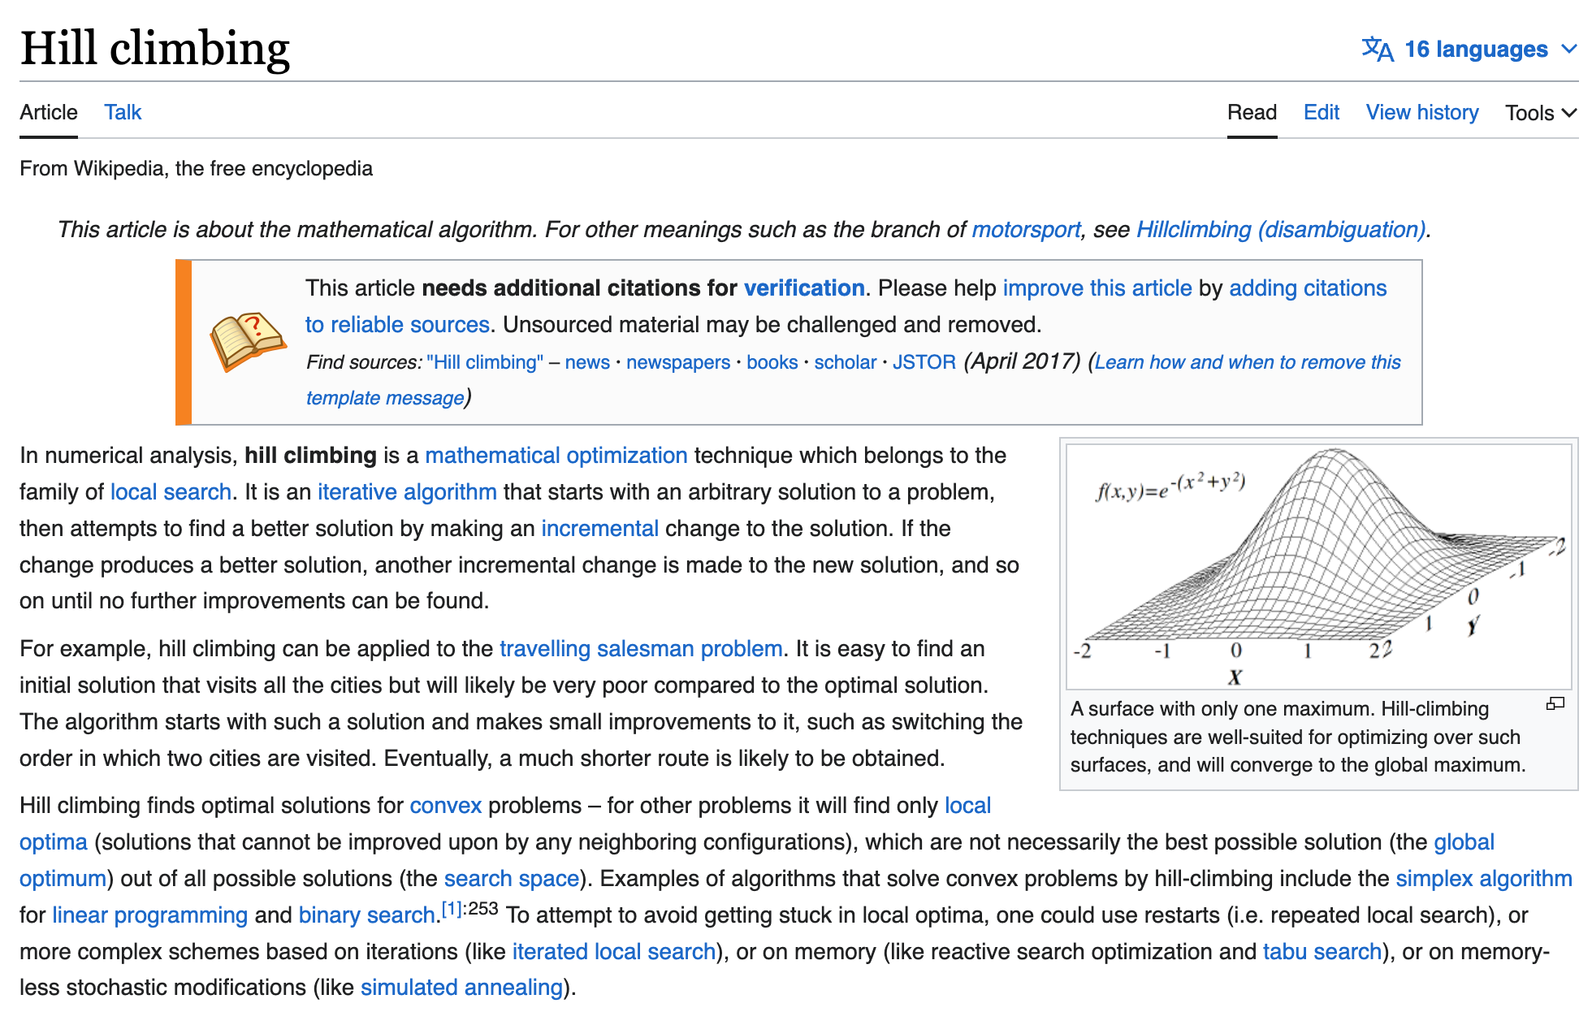
https://en.wikipedia.org/wiki/Hill_climbing

Slide 40
Trainer https://huggingface.co/learn/nlp-course/chapter3/3?fw=pt

Slide 41
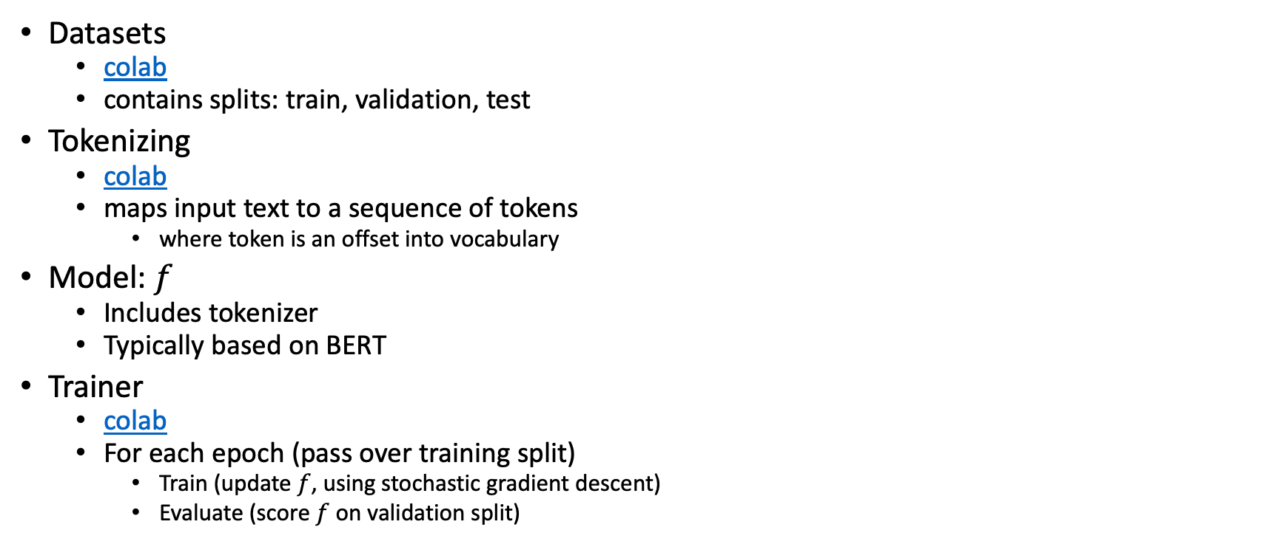
Steps (Review)
Datasets
colab
contains splits: train, validation, test
Tokenizing
colab
maps input text to a sequence of tokens
where token is an offset into vocabulary
Model: $f$
Includes tokenizer
Typically based on BERT
Trainer
colab
For each epoch (pass over training split)
Train (update $f$, using stochastic gradient descent)
Evaluate (score $f$ on validation split)

Slide 42
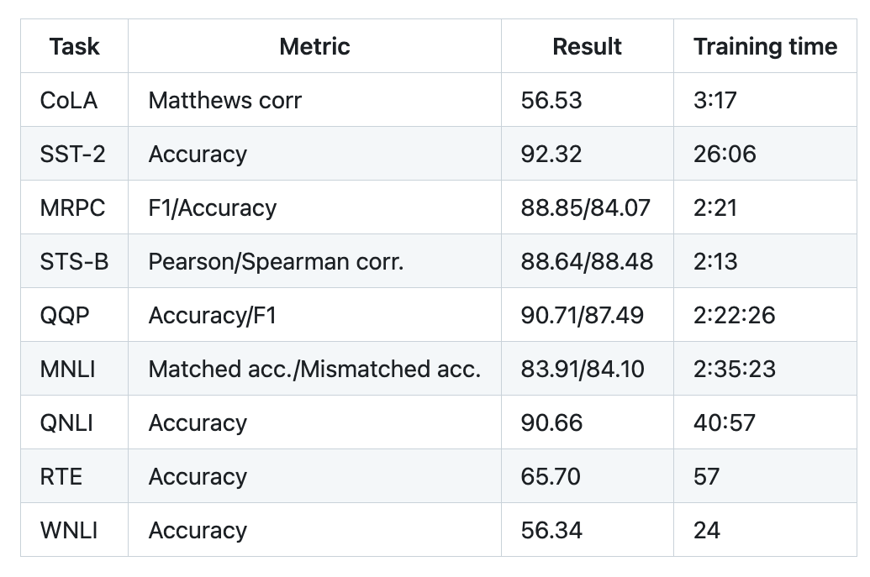


Metric v. Loss
Subset | Dataset | Equation
COLA | H:glue,cola | $$classify : label \sim sentence$$
SST2 | H:glue,sst2 | $$classify : label \sim sentence$$
WNLI | H:glue,wnli | $$classify : label \sim sentence$$
MRPC | H:glue,mrpc | $$classify : label \sim sentence1 + sentence2$$
QNLI | H:glue,qnli | $$classify : label \sim sentence1 + sentence2$$
QQP | H:glue,qqp | $$classify : label \sim question+sentence$$
SSTB | H:glue,sstb | $$regress : label \sim question1+question2$$
MNLI | H:glue,mnli | $$classify : label \sim premise+hypothesis$$
Training Step
Optimize loss in SGD
Requirement:
loss is differentiable
Users no longer need to know how to differentiate loss
with modern frameworks:
pytorch, tensorflow
Evaluation Step
Use metric to score $f$
Ideally, loss $≈$ metric
https://github.com/huggingface/transformers/blob/main/examples/pytorch/text-classification/README.md
Not much better than chance

Slide 43

Loss Functions in Deep Learning https://insideaiml.com/blog/LossFunctions-in-Deep-Learning-1025

Slide 44

Winograd Schema (GLUE WNLI)
The trophy doesn't fit in the brown suitcase
because it is too large.
What is too large?
A. The trophy
B. The suitcase
Not much better than chance
from: https://doi.org/10.1016/j.artint.2023.103971

Slide 45


Winograd Schema (GLUE WNLI)

Slide 46
Steps (Review, again)
Datasets
colab
contains splits: train, validation, test
Tokenizing
colab
maps input text to a sequence of tokens
where token is an offset into vocabulary
Model: $f$
Includes tokenizer
Typically based on BERT
Trainer
colab
For each epoch (pass over training split)
Train (update $f$, using stochastic gradient descent)
Evaluate (score $f$ on validation split)

Slide 47



https://github.com/huggingface/transformers/blob/main/examples/pytorch/text-classification/run_glue.py
Trainer
colab
For each epoch
Train (update $f$, using SGD)
Evaluate (score $f$ on validation split)

Slide 48

https://github.com/huggingface/transformers/blob/main/examples/pytorch/text-classification/run_glue_no_trainer.py
with trainer
649 lines of code
without trainer
665 lines of code
SGD is more obvious
in both cases,
the example is hardwired for GLUE
no clear distinction between
foreground:
GLUE-specific functionality
Names of tasks, loss, metric
background:
General purposefunctionality that applies to many/most classification problems

Slide 49

https://github.com/huggingface/transformers/blob/main/examples/pytorch/text-classification/run_glue_no_trainer.py

Slide 50
Running Cola on Discovery # Virtual Environment
module load python/3.8.1
python3 -m pip install --user --upgrade pip
python3 -m pip install --user virtualenv
python3 -m venv $HOME/venv/transformers
source $HOME/venv/transformers/bin/activate
pip install --upgrade pip
cd /work/k.church/githubs/transformers
pip install -e .
cd /work/k.church/githubs/transformers/examples/pytorch/text-classification/
pip install -r requirements.txt
pip install urllib3==1.26.6

Slide 51

Running Cola on Discovery
outdir=/courses/CS6120.202410/data/GLUE/model_outputs/cola
mkdir -p $outdir
dir=/work/k.church/githubs/transformers/examples/pytorch/text-classification
cd $outdir
sh ./cola.sh
https://github.com/google-research/bert

Slide 52
Agenda
Homework
Assignment 2: HuggingFace Pipelines
Background Material
Old Business
Colab
Deep Nets: Inference
Classification & Regression
Anything → Vector
Machine Translation
Fill Mask
New Business
bertviz
Deep Nets: Fine-Tuning
Easy: inference
Hard: pre-training
Not too hard: fine-tuning
Code: colab
HuggingFace Tutorial
HuggingFace Colab
run glue example

